Slide 1



Authentication using Behavioral Biometrics
Jaypee University of Information Technology
Department of Computer Science and Engineering and Information Technology
Major Project - II (18B19CI891) | AY 2024-25
End-Term Evaluation | May 16-17, 2025.
Group No.: 36
Team Member (s)
Akshit Sharma (211435)
Simran (211442)
Supervisor (s)
Name: Dr. Kushal Kanwar
Designation: Assistant Professor (SG)
Department: CSE & IT

Slide 2
Outline
Introduction
Problem Statement
Objectives
Work Done (after Mid-Term Evaluation)
Project Design
Implementation
Experimental Results and Evaluation
Key Learnings
Future Work
Work Contribution and Attendance
Supervisor Interactions
References

Slide 3
Introduction
Three key factors of authentication:
Something you know
Something you have
Something you are
Something you are : the way you behave / interact, that is, patterns in device usages.
Base for our use : Sensor dynamics and touch strokes.
Our project aims to provide a seamless and non-intrusive form of second-factor authentication. It improves both usability and security. The project aims to authenticate a user, that is, know if the user is really him/herself, using their human behavioral traits, such as the way one holds their mobile phone
.

Slide 4
Problem Statement
Data security by means of authentication is emerging as a very prevalent challenge in today’s world.
The need to balance usability and security is high, as by nature, we humans tend to avoid effort.
To achieve this, service providers must invest in a lot to analyze user patterns in their activity, which is not only resource heavy, but also opens a door for privacy breaches on the user side.
Our proposed solution is to use behavioral biometrics, a relatively underexplored field, in which we use behavioral data from the user, in this case, the way he/she handles his/her phone.

Slide 5
Objectives
To develop an application to gather a user’s natural behavioral information.
To develop and tailor a machine learning model to accurately identify a particular user.
To develop a prototype that implements the concept of the project.
The main objective of this project was to provide a highly secure and continuous second factor of authentication to users as well as services. At this stage, we are focusing on serving the mobile applications that require this security, such as banking or online shopping services, employee portals, and even parental controls on niche applications.

Slide 6
Work Done (after Mid-Term Evaluation)
As per the plan stated in the Mid Term Evaluation presentation, we have successfully implemented LSTM and GRU on the pre-processed data.
Converted the GRU model into a TensorFlow Lite (.tflite) version to be used in the mobile app.
Designed a mobile app prototype on Figma.
Implemented the features in an android application using Dart and the Flutter framework.

Slide 7
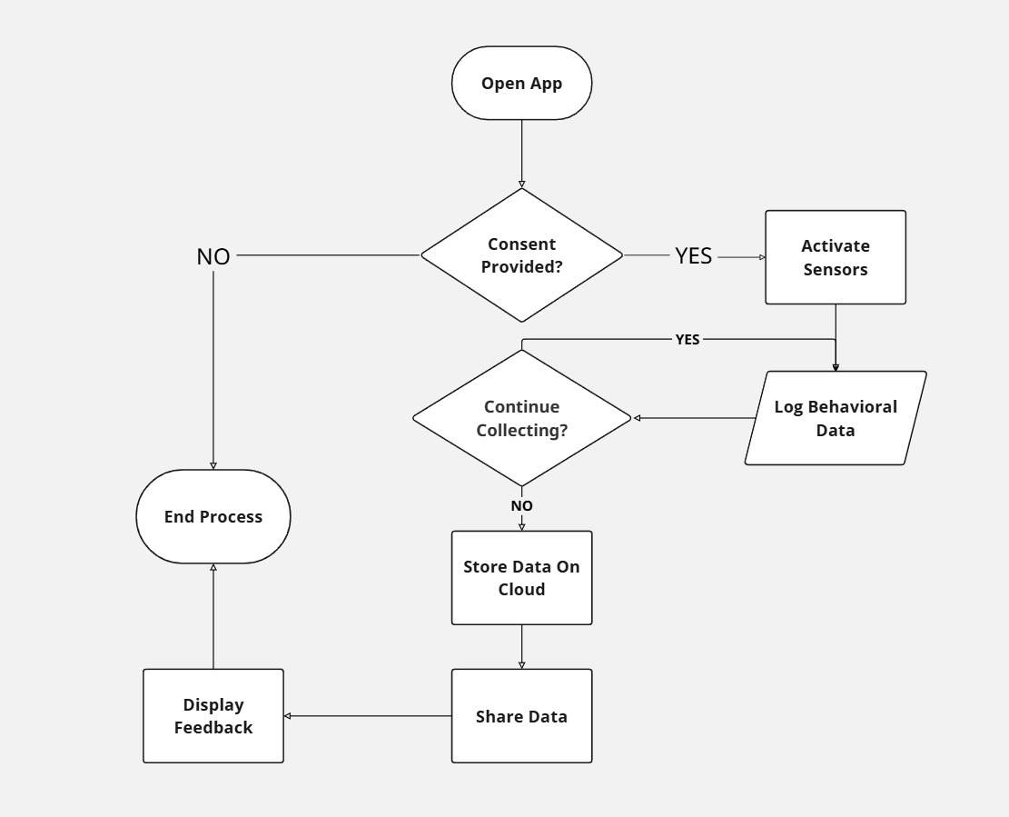
Project Design
Open App: The process begins.
The system checks if the required sensors are enabled, and permissions are granted.
If No, it stops.
If Yes, it proceeds to collect data from the sensors.
Till the user stops the data collection, the app collects the data and stores it locally in a .csv file.
The user then stops the data collection and shares it.
End: The process ends.
Fig.1.1: Flow graph of the data collection app.

Slide 8
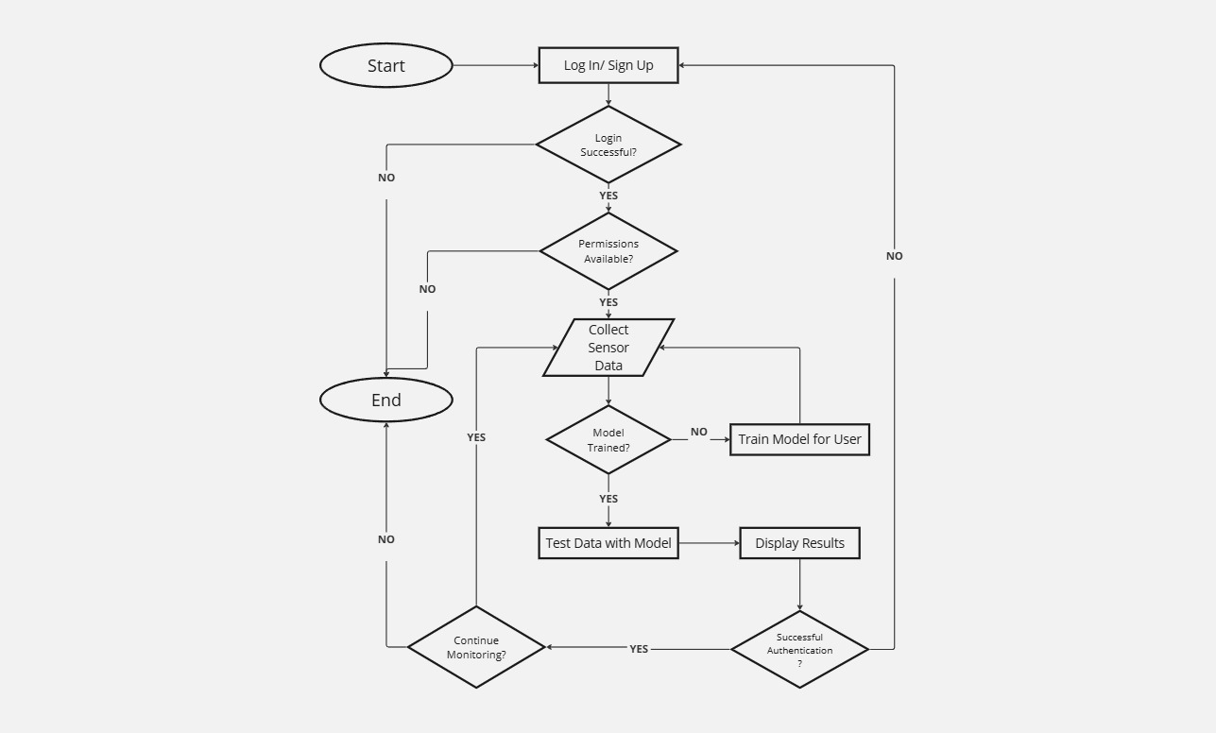
Project Design (cont…)
Once all required permissions are granted, and the model is trained, the app verifies every ‘x’ minutes.
IF Confidence Score > Threshold:
VERIFIED text, countdown to next Check.
ELSE:
MISMATCH text, check 1) More Frequently 2) Bigger Sample Size
IF Confidence Score > Threshold:
Return to VERIFIED text, countdown to next Check.
ELSE:
Check again, if number of times checked < 9.
Force Log out.
If user logs in successfully, retrain the model.
Fig.1.2: Flow graph of the prototype.

Slide 9
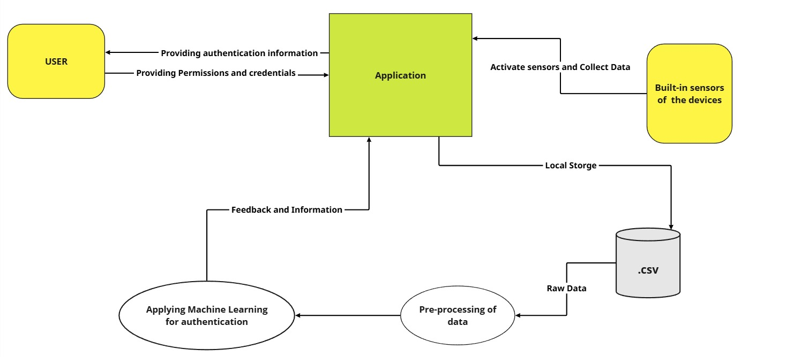
Project Design (cont…)
Fig.1.3: Data Flow Diagram (DFD) of the project.

Slide 10
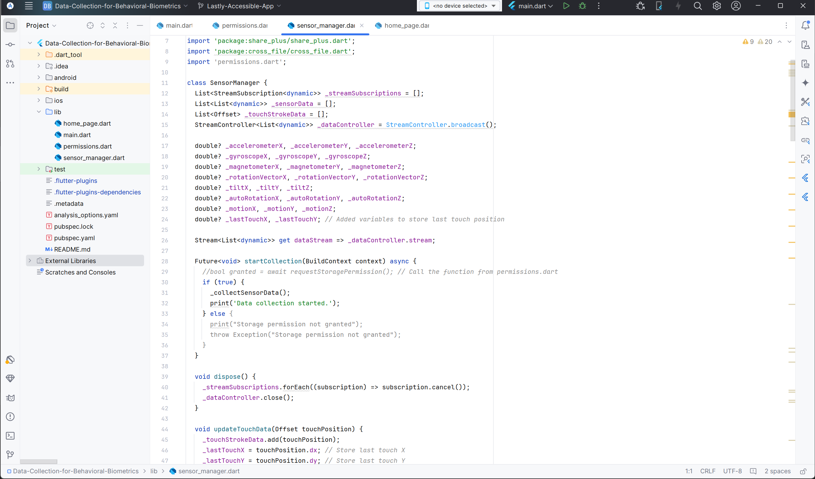
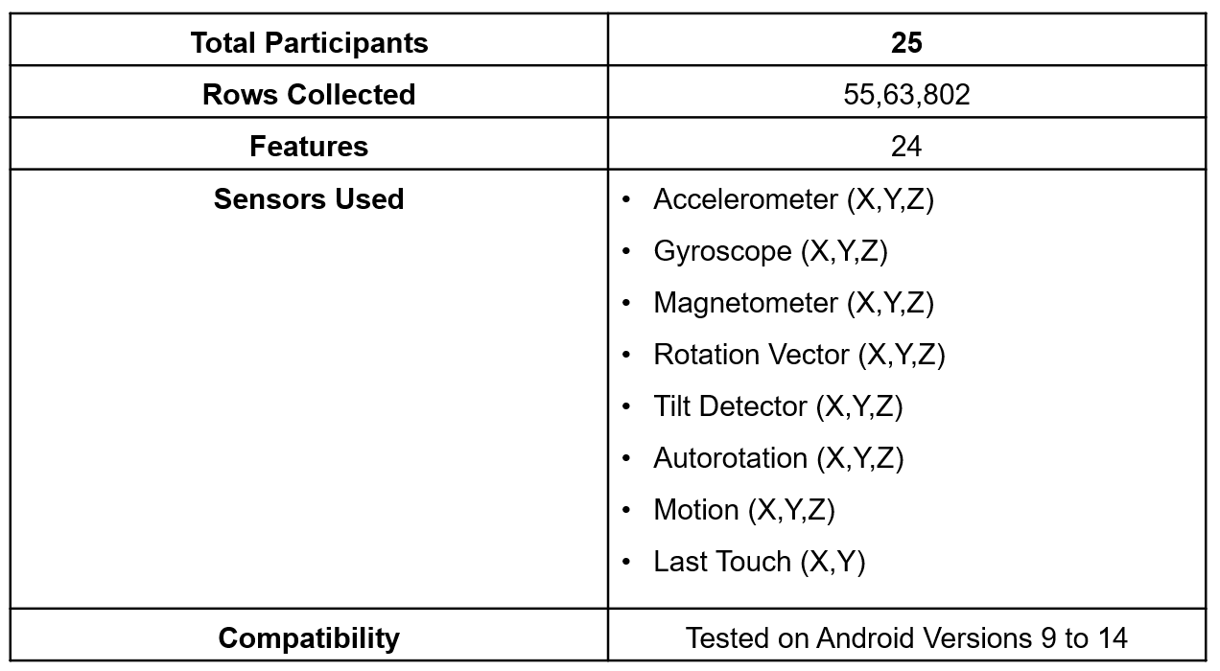
Implementation
Using this Data Collection App, we were able to generate a dataset consisting of data from 25 participants, as follows:
Table 2.1: Key Metrics of the Data Collected
Fig.2.1: sensor_manager.dart code base

Slide 11
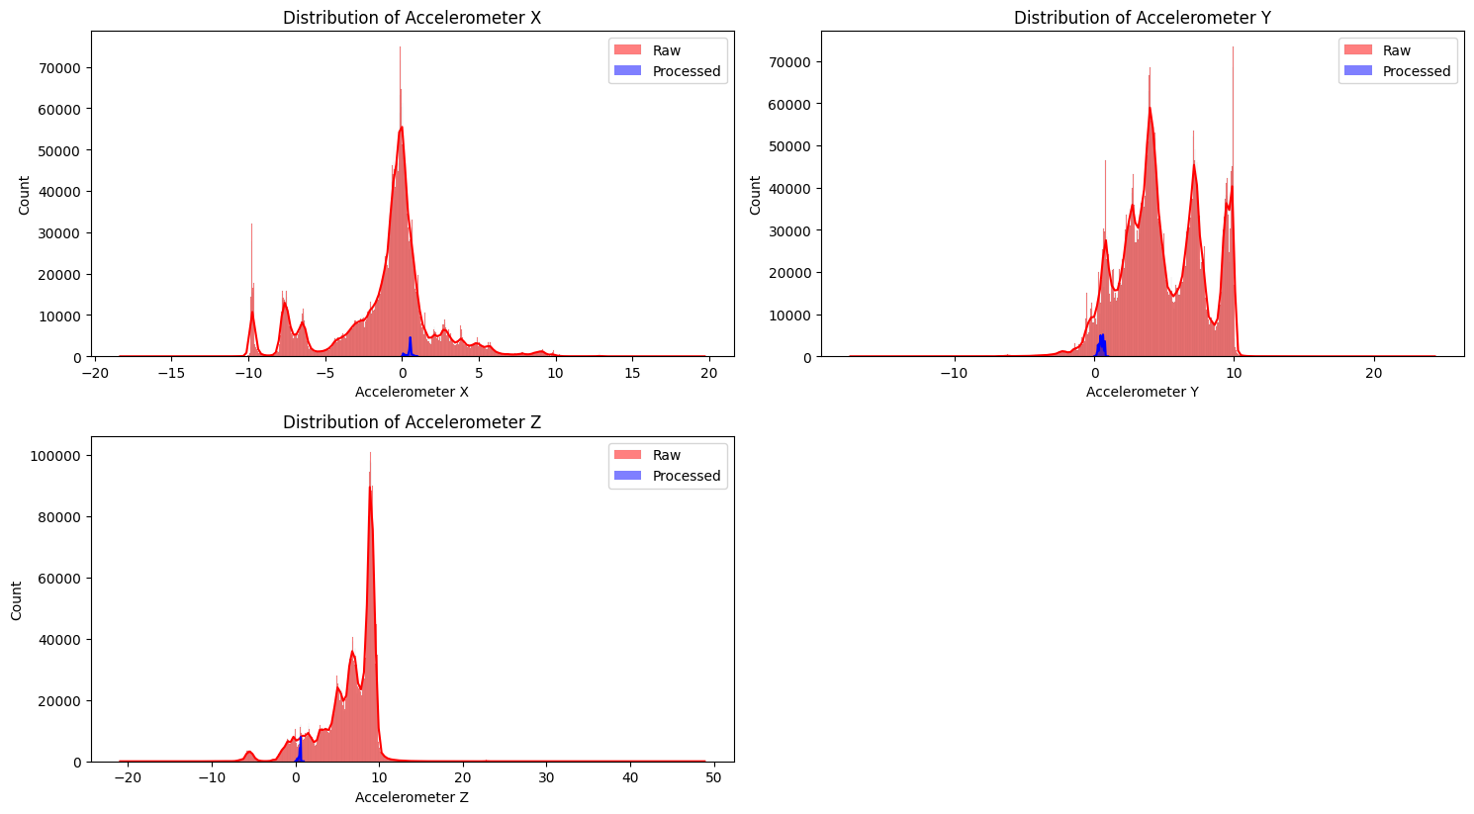
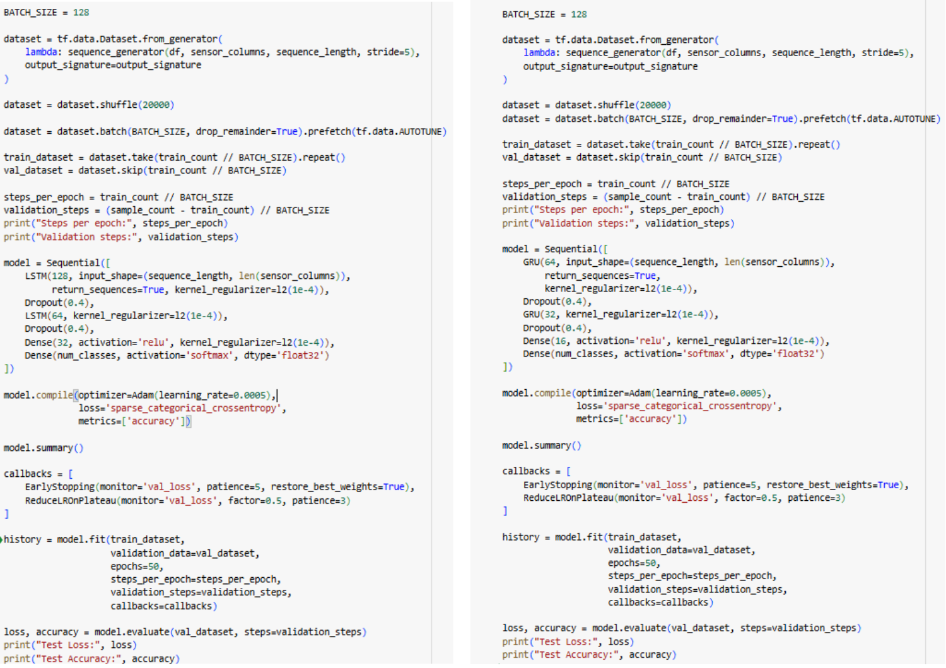
Implementation (cont…)
Fig.2.2: Collected v/s Used data, and the LSTM and GRU Codebases

Slide 12
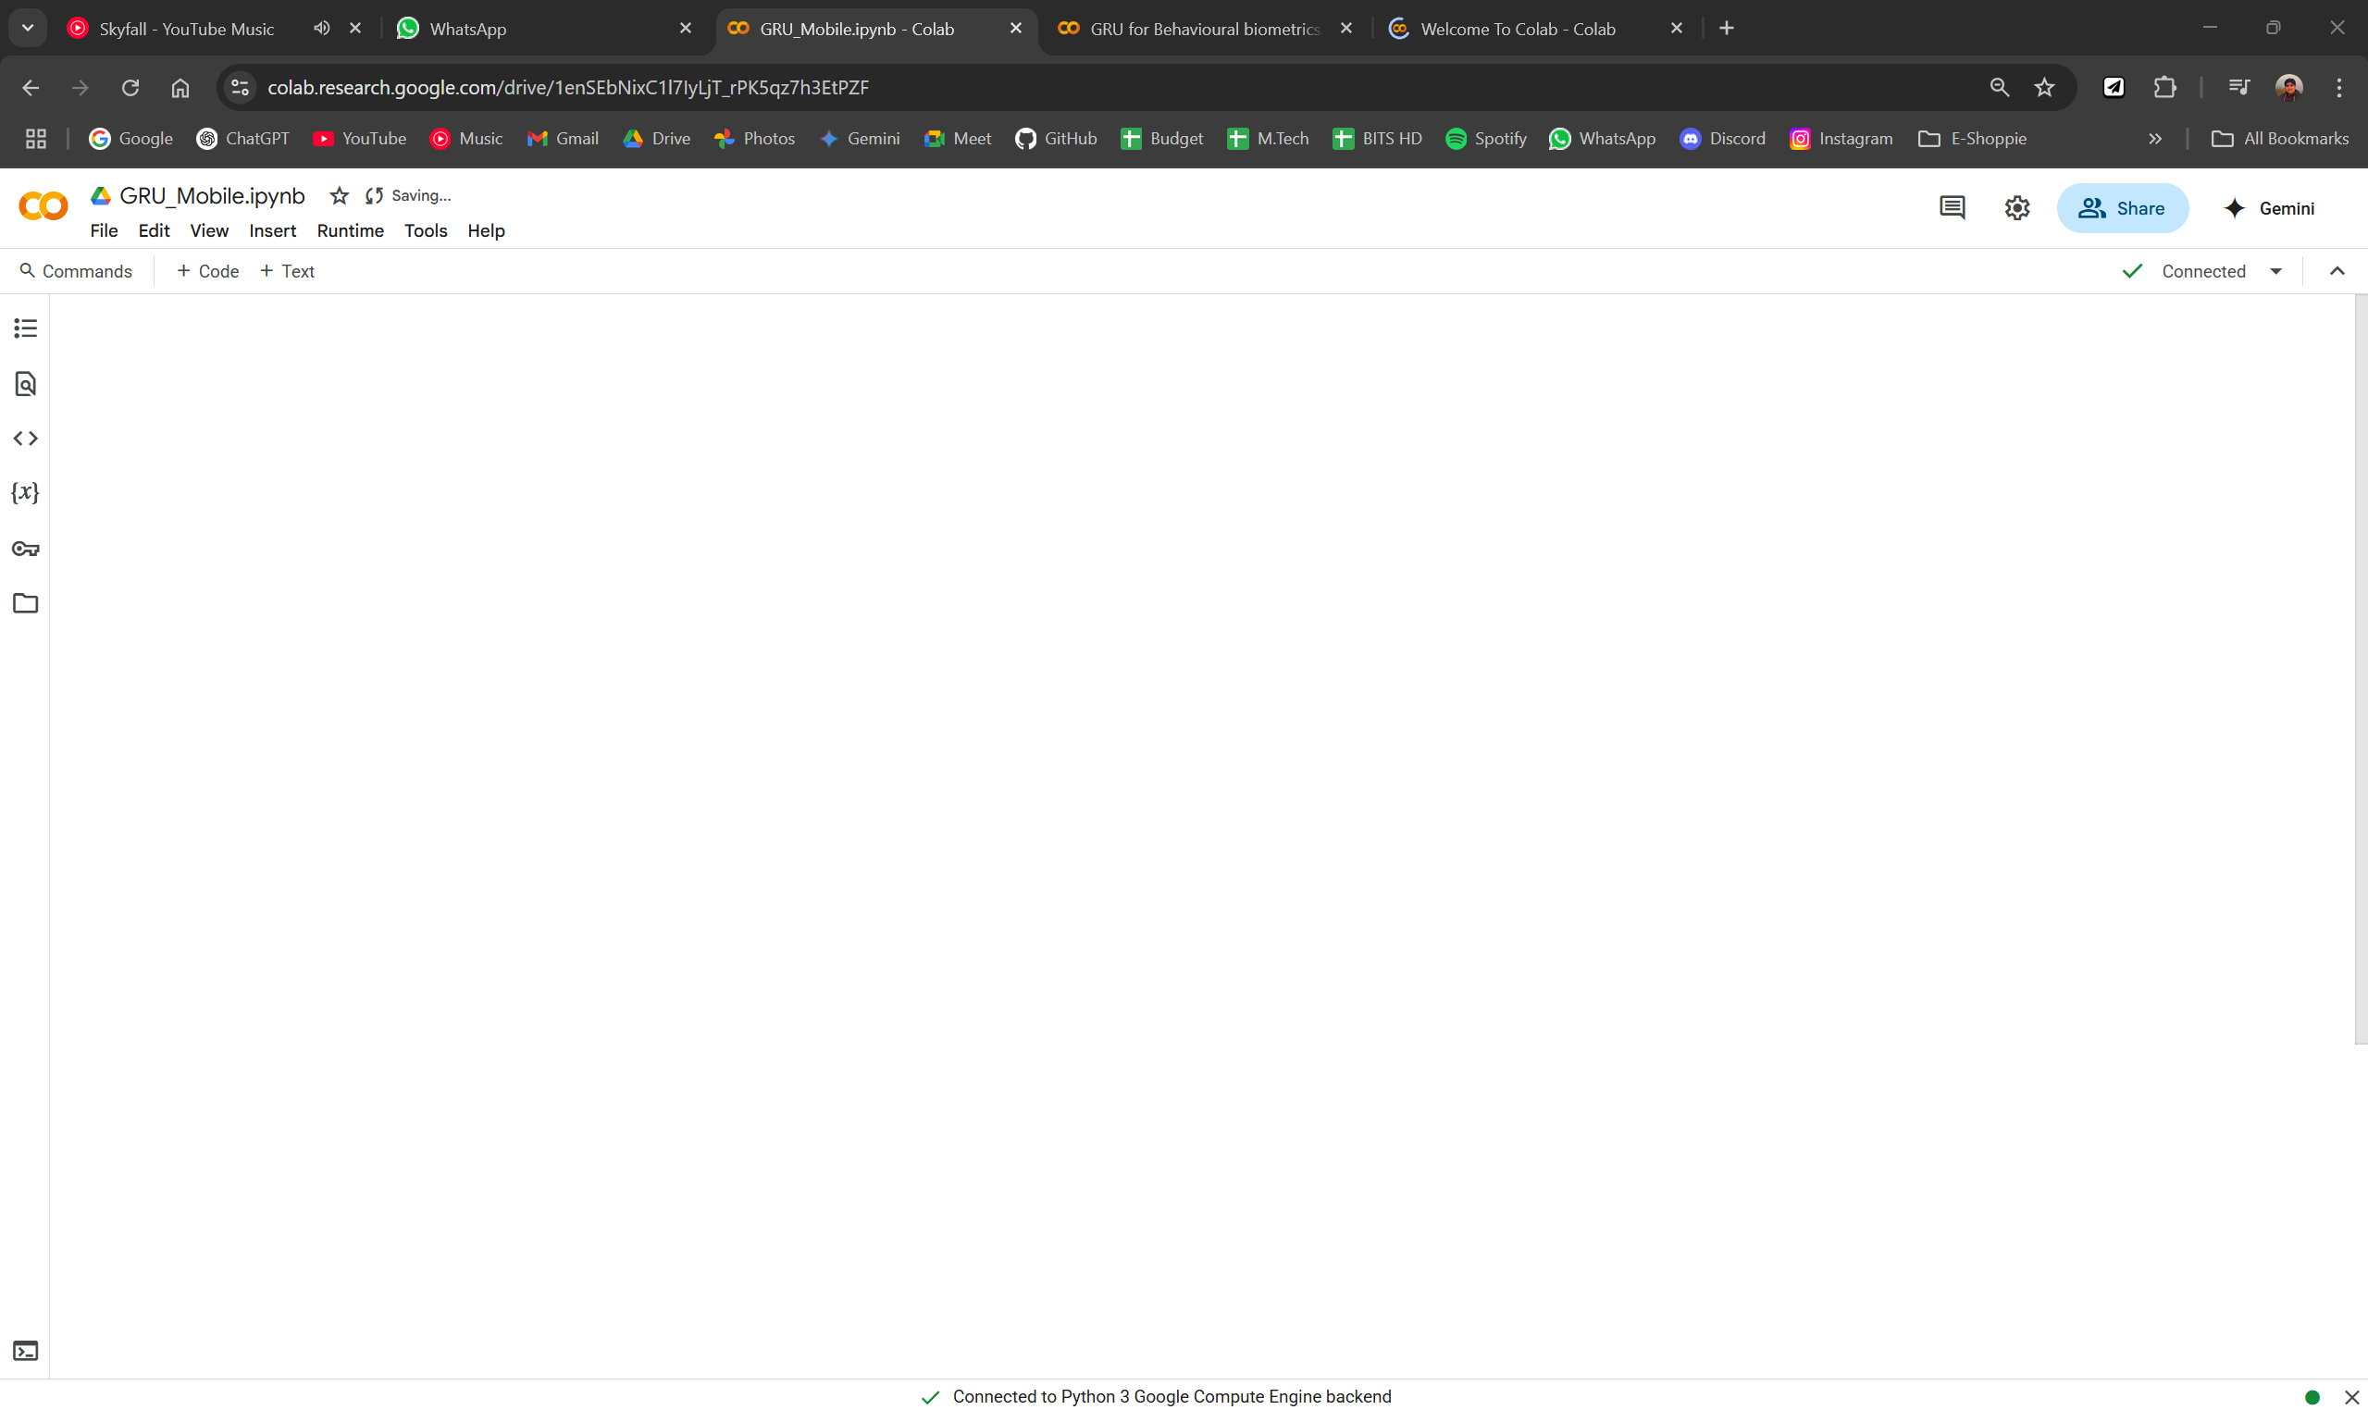
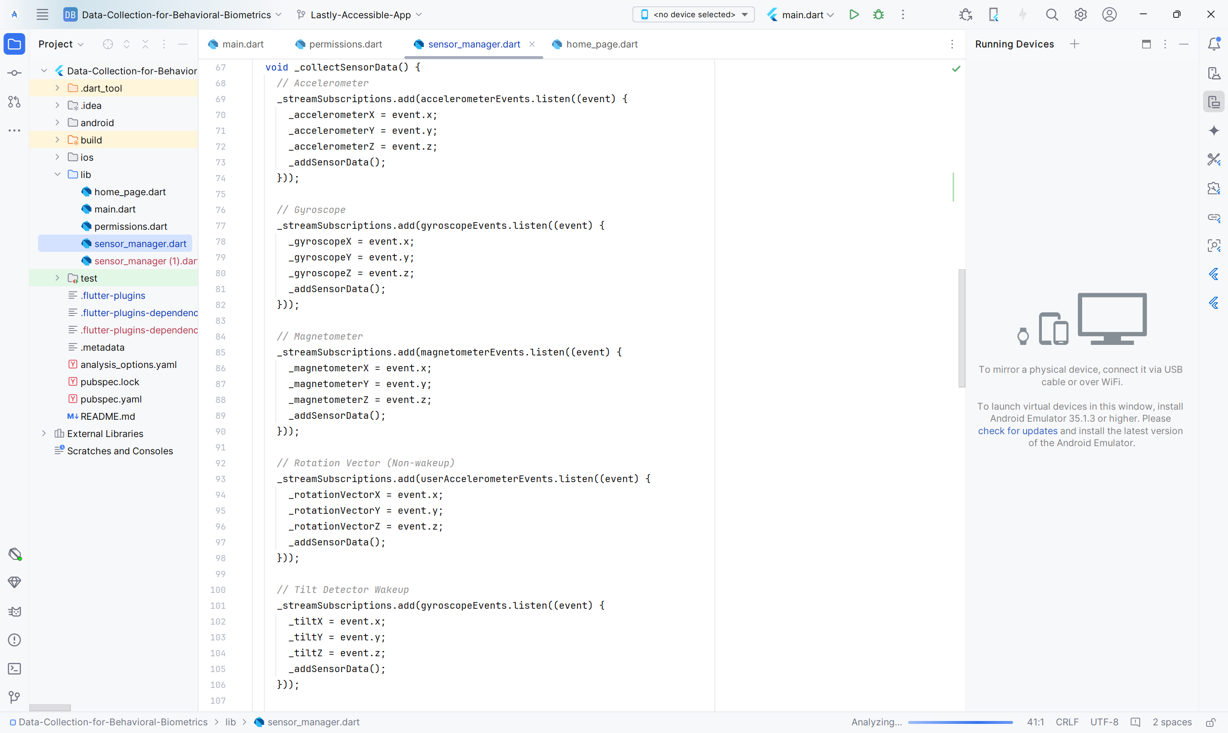
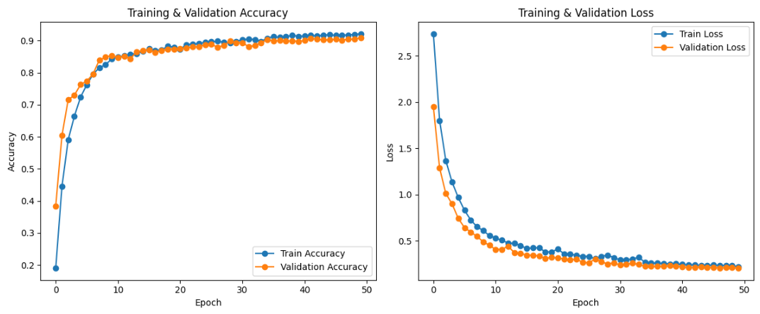
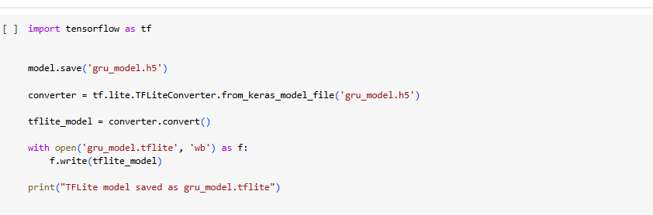
Implementation (cont…)
Fig.2.3: Converting the GRU model into a mobile version (.tflite)

Slide 13
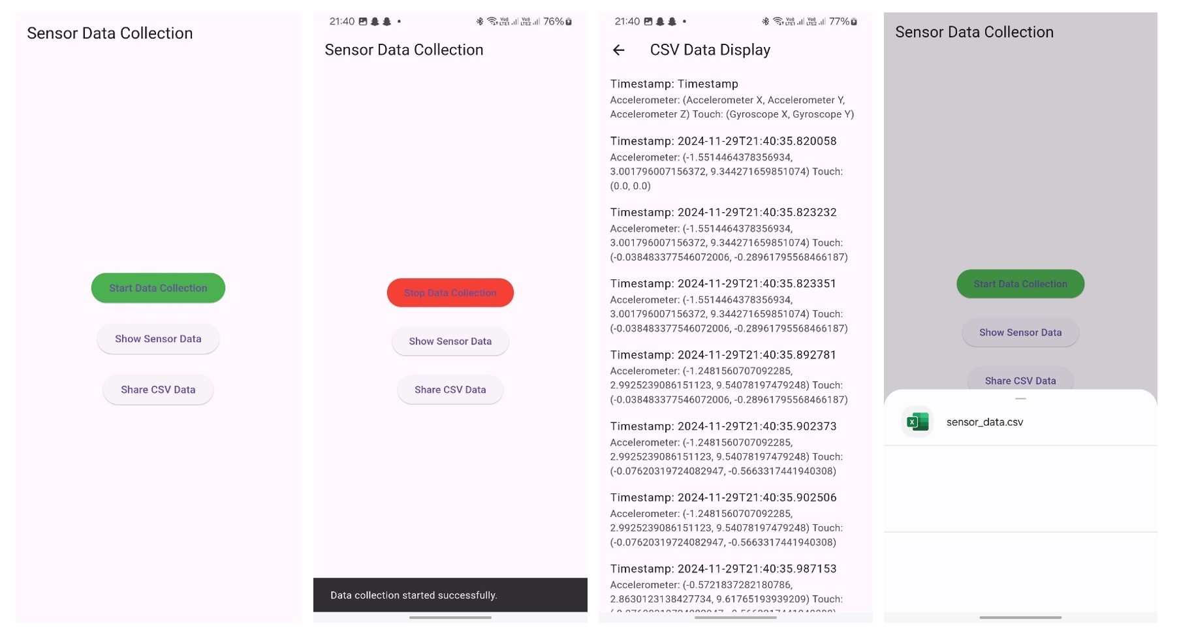
Experimental Results and Evaluation
Fig.3.1: The Data Collection Application.

Slide 14
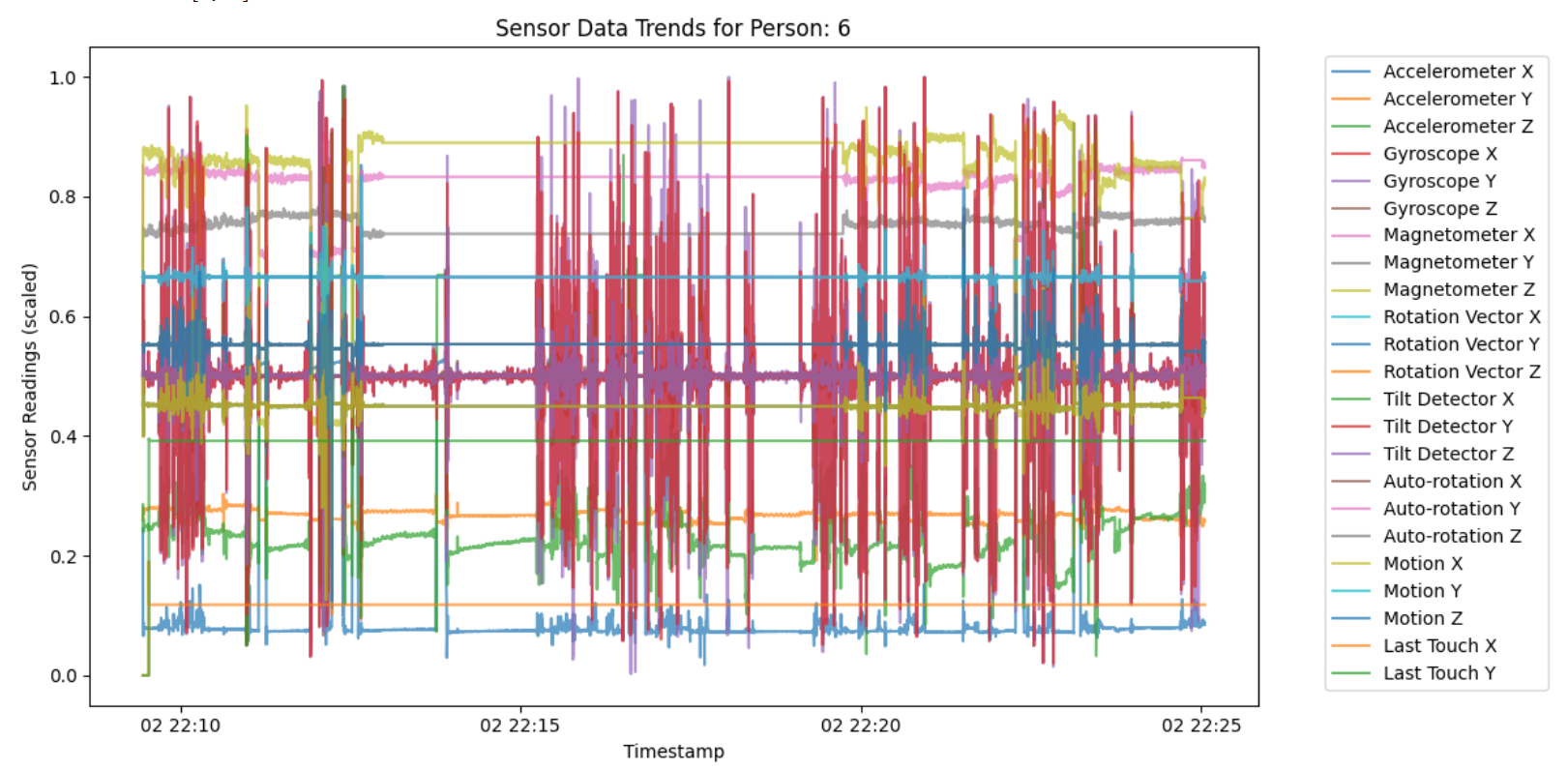
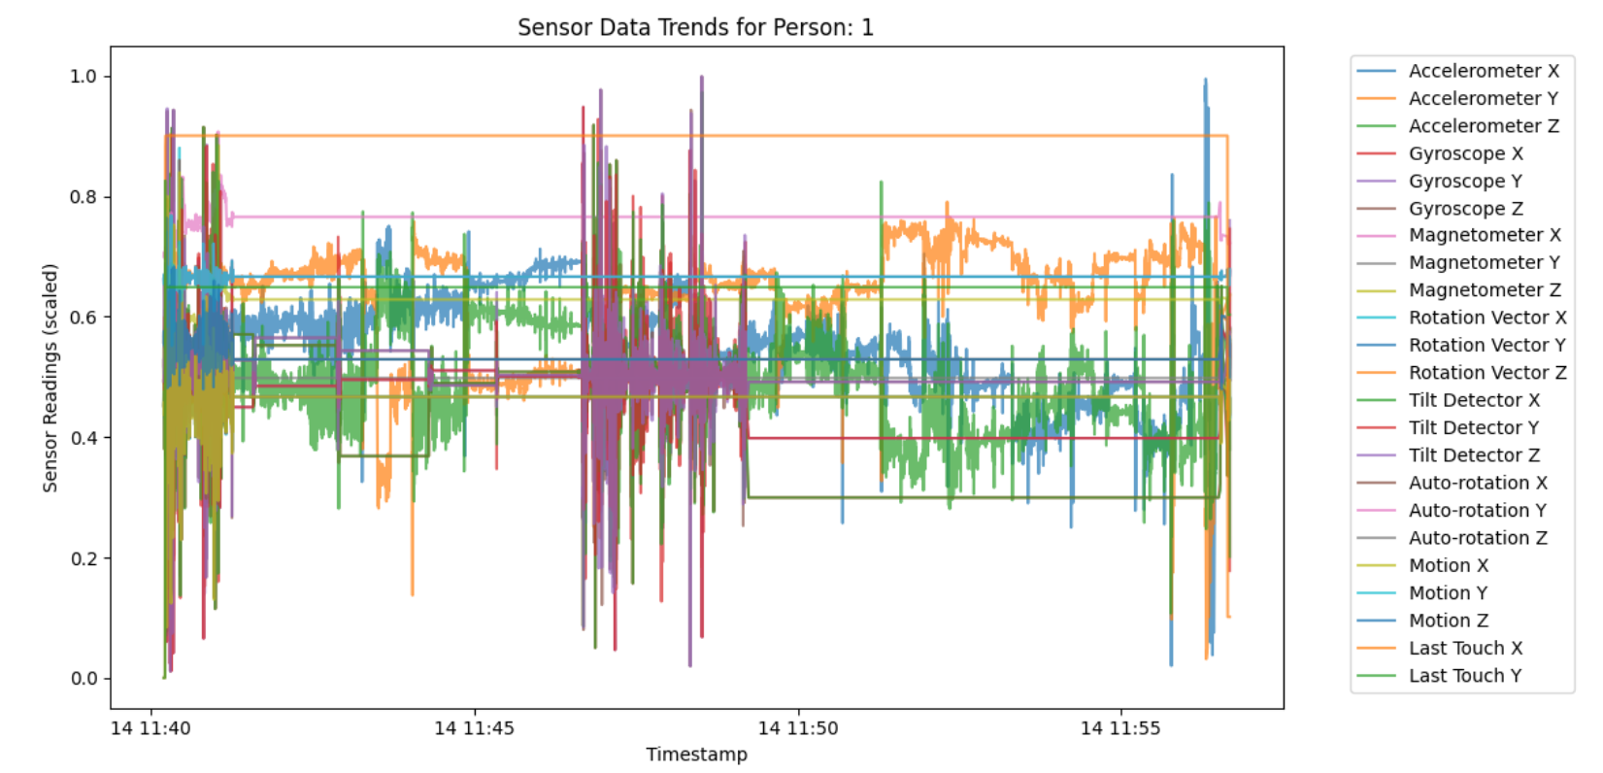
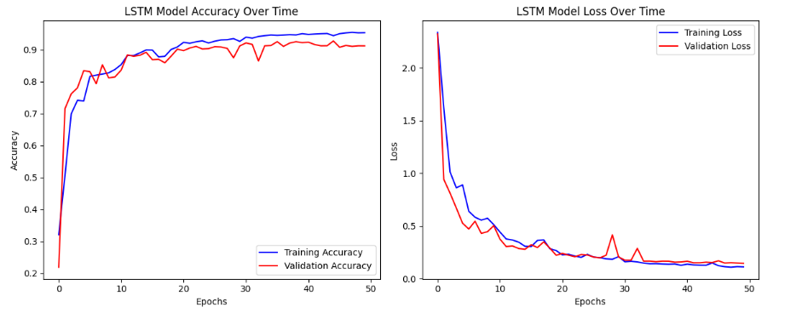
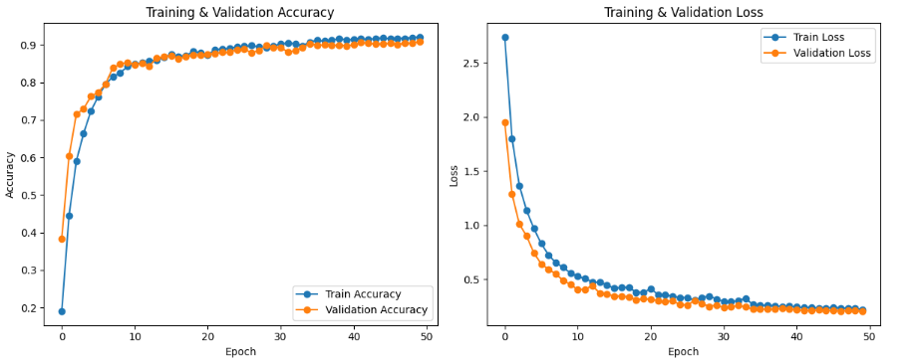
Experimental Results and Evaluation (cont…)
Fig.3.2: Differences in Data Collected, and Accuracies achieved with LSTM & GRU.

Slide 15
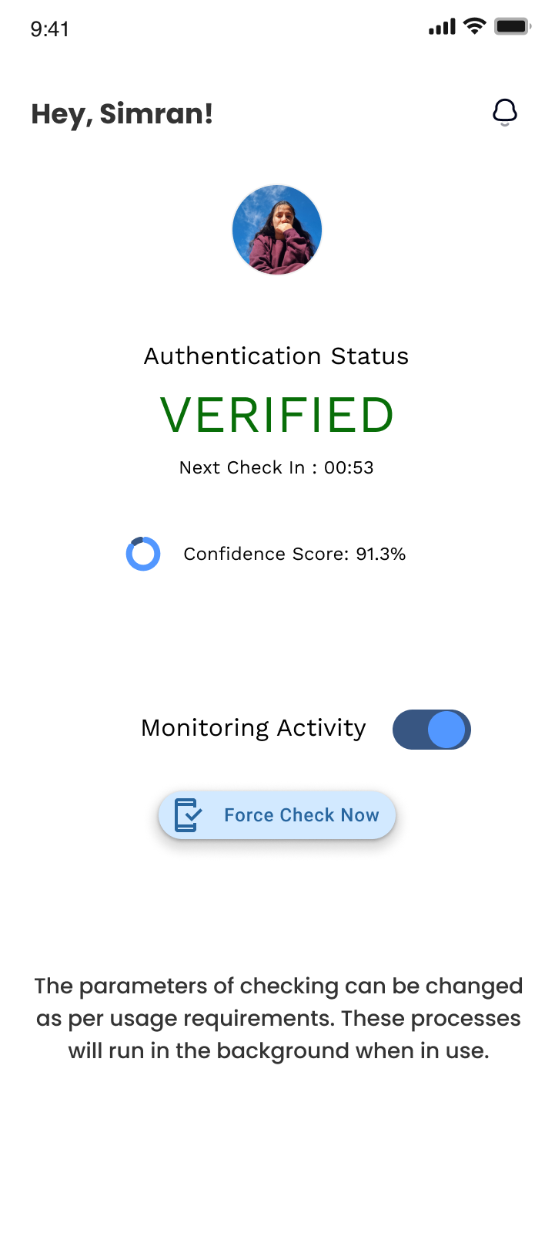
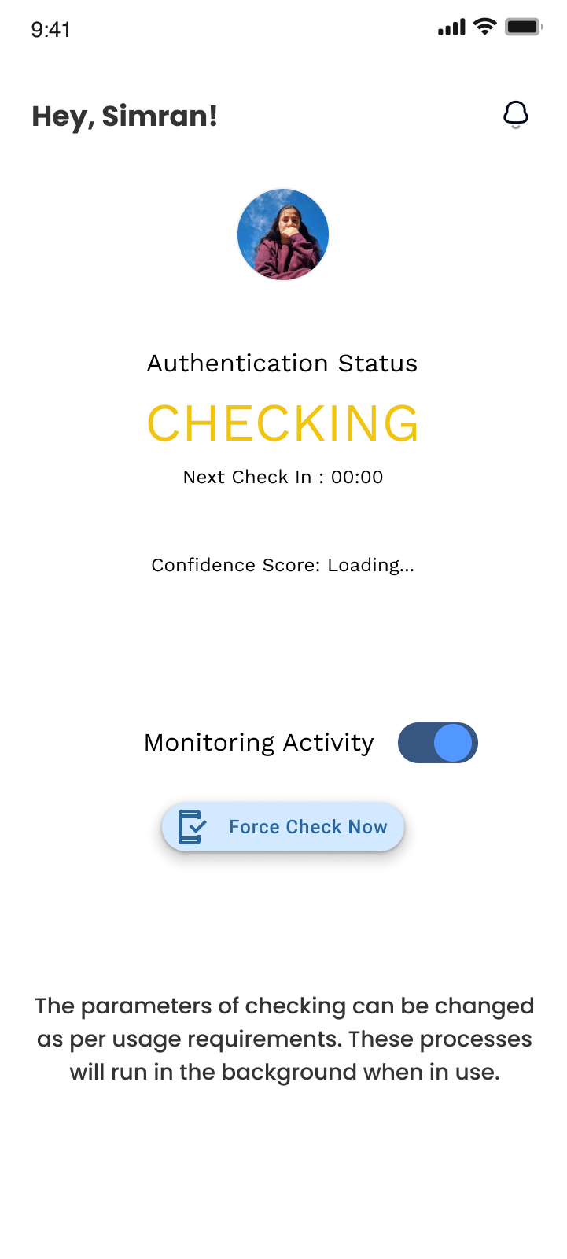
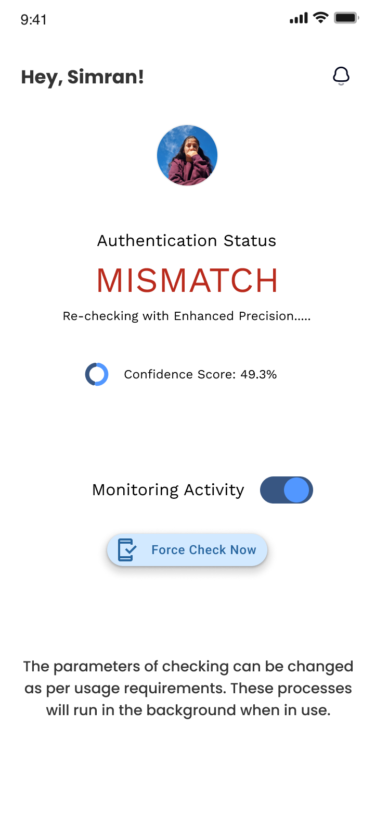
Experimental Results and Evaluation (cont…)
Fig.3.3: The Prototype App States

Slide 16
Key Learnings
We learnt about app development using flutter, and about using android plug-ins to extract data from a phone.
Also learnt how to handle, share, pre-process and use that data.
Additionally, also got an introduction to Machine and Deep Learning Models.
Also learnt how to follow a process for app development, and how to balance design and development.

Slide 17
Future Work
To expand the dataset to include more variety, in terms of people and situations.
To deploy the authentication technique in a real mock banking app, or any other app requiring high-security to demonstrate the use case.
To write about our work in a research paper highlighting the data collected, the research done and the authentication technique adapted.

Slide 18
Work Contribution and Attendance
GitHub Repository URL: https://github.com/SimranBytes/Authentication_Using_Behavioral_Biometrics
Team Member | Roll No. | Work Done (provide complete details) | Work Contribution (%) | Lines of Code (LoC) | Lab Attendance (%)
1. | 211435 | Designed the prototype in Figma Converted GRU model into a mobile friendly version. Documentation & Write-up | 50% | 427 (Apps) 227 (Colab) | 100%
2. | 211442 | Prototype Development – Flutter Bug fixes in data collection app Documentation & Write-up | 50% | 532 (App) 204 (Colab) | 100%

Slide 19
Supervisor Interactions (as mentioned in weekly log)
Yes
Yes
Yes
Yes
Yes
No. of Meetings with Supervisor: 15+
Week No. | Duration | Remarks (as mentioned in the weekly log) | Incorporated (Yes/No)
1. | 17/03/2025 to 22/03/2025 | OK | Yes
2. | 24/03/2025 to 29/03/2025 | OK | Yes
3. | 31/03/2025 to 05/04/2025 | OK | Yes
4. | 14/04/2025 to 19/04/2025 | OK | Yes
5. | 21/04/2025 to 26/04/2025 | OK | Yes

Slide 20
Supervisor Interactions (cont…)
Week No. | Duration | Remarks (as mentioned in the weekly log) | Incorporated (Yes/No)
6. | 28/04/2025 to 03/05/2025 | OK | Yes
7. | 05/05/2025 to 10/05/2025 | OK | Yes

Slide 21
References
[1] O. L. Finnegan, J. W. White III, and B. Armstrong, "The utility of behavioral biometrics in user authentication and demographic detection: A scoping review," Syst. Rev., vol. 13, no. 1, p. 45, 2024.
[2] L. Sun, Y. Wang, Y. Ren, and F. Xia, "Path signature-based XAI-enabled network time series classification," Sci. China Inf. Sci., vol. 67, no. 4, pp. 1–15, 2024.
[3] E. C.-Y. Su and H.-M. Wu, "Dimension reduction and visualization of multiple time series data: A symbolic data analysis approach," Comput. Stat., vol. 39, no. 2, pp. 123–140, 2024.
[4] P. Bansal and A. Ouda, "Continuous authentication in the digital age: An analysis of reinforcement learning and behavioral biometrics," Computers, vol. 13, no. 6, p. 78, 2024.
[5] P. Yris, et al., "Deep features fusion for user authentication based on human activity," IET Biometrics, vol. 12, no. 1, pp. 45-57, 2023.
[6] R. Praveen, et al., "Continuous user authentication on smartphone via behavioral biometrics: a survey," Multimedia Tools and Applications, Springer, 2023.
[7] G. Stragapede, et al., "Mobile behavioral biometrics for passive authentication," Pattern Recognition Letters, vol. 157, pp. 130-140, 2022.
[8] Z. Shihong, et al., "A Robust Continuous Authentication System Using Smartphone Sensors and Wasserstein Generative Adversarial Networks," Communication Security in Socialnet-Oriented Cyber Spaces, 2021.

Slide 22
References (cont…)
[9] B. Lavanya, et al., "Impact of Behavioral Biometrics on Mobile Banking System," Journal of Physics: Conference Series, Advances in Computational Electronics and Communication Engineering, vol. 1964, 2021.
[10] G. Jianfeng, et al., "Design and Implementation of Continuous Authentication Mechanism Based on Multimodal Fusion Mechanism," Communication Security in Socialnet-Oriented Cyber Spaces, 2021.
[11] S. Ioannis, et al., "Behavioral biometrics & continuous user authentication on mobile devices: A survey," Information Fusion, 2021.
[12] M. Abuhamad, et al., "Sensor-based continuous authentication of smartphones’ users using behavioral biometrics: A contemporary survey," IEEE Internet of Things Journal, 2021.
[13] I. Alsaadi, "Study on most popular behavioral biometrics, advantages, disadvantages and recent applications," International Journal of Scientific & Technology Research, vol. 10, no. 12, pp. 320-326, 2021.
[14] T. L. Xu, K. de Barbaro, D. H. Abney, and R. F. A. Cox, "Finding structure in time: Visualizing and analyzing behavioral time series," Front. Psychol., vol. 11, p. 2735, 2020.
[15] A. Alzubaidi and J. Kalita, "Authentication of smartphone users using behavioral biometrics," IEEE Communications Surveys & Tutorials, vol. 18, no. 3, pp. 1998-2026, 2016.
[16] A. Buriro, B. Crispo, F. Del Frari, and K. Wrona, "Touchstroke: Smartphone user authentication based on touch-typing biometrics," Springer International Publishing, 2015.

Slide 23
References (cont…)
[17] N. Zheng, K. Bai, H. Huang, and H. Wang, "You are how you touch: User verification on smartphones via tapping behaviors," IEEE, 2014.
[18] H. Saevanee and P. Bhattarakosol, "Authenticating user using keystroke dynamics and finger pressure," IEEE Proceedings of the International Conference on Computing and Convergence Technology, 2009.
[19] L. Li, X. Zhao, and G. Xue, "Unobservable re-authentication for smartphones," IEEE Transactions on Mobile Computing, vol. 12, no. 2, pp. 1-10, 2013.
[20] X. Zhao, T. Feng, and W. Shi, "Continuous mobile authentication using a novel graphic touch gesture feature," IEEE Transactions on Mobile Computing, vol. 12, no. 9, pp. 1-15, 2013.
[21] A. De Luca, A. Hang, F. Brudy, C. Lindner, and H. Hussmann, "Touch me once and I know it's you! Implicit authentication based on touch screen patterns," in Proceedings of the ACM Conference on Human-Computer Interaction with Mobile Devices and Services (MobileHCI), 2012.

Slide 24

Thanks.

